Slide 1
Learning to cooperate or “How I became a good neighbor”
Milos Rovcanin

Slide 2
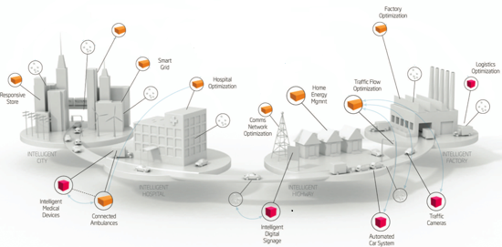
Status quo
Enormous increase in a density of co-located, multi-purpose networks.

Slide 3
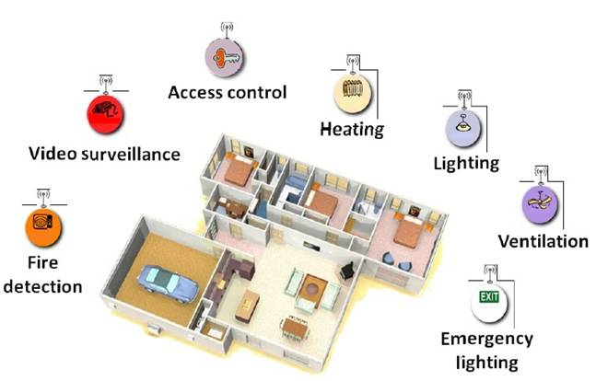
Zooming in
Pretty soon, a typical household unit will be equipped with a number of
wireless networks, for all sorts of purposes: controlling temperature,
access to premises, temperature, ventilation etc.

Slide 4
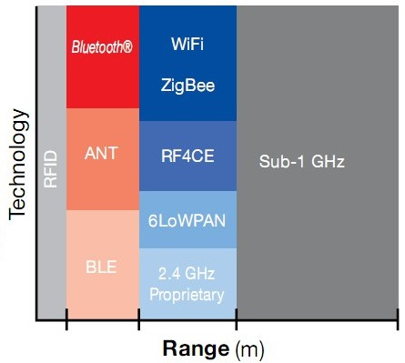
Network diversity
A huge variety of network preferences and their hardware/software capabilities:
Wifi standards IEEE 802.11a, 802.11b, 802.11g and 802.11n (at 2.4 GHz)
Zigbee standard IEEE 802.15.4 (at 2.4 GHz)
6LoWPAN (RFC 4944) standard IEEE 802.15.4 (at 2.4 GHz)
ONE-NET is an open-source standard for designed for low-cost, low-power control networks
Bluetooth standard 802.15.1 (2.4 up to 2.8 GHz)
Bluetooth Low Energy (Wibree) is a subset to Bluetooth V4.0 with an entirely new protocol stack for rapid build-up of simple links.
ANT: ANT is a proprietary wireless sensor network technology operating at 2.4 GHz that provides a low-cost and ultra-low power solution for short-range wireless communication in point-to-point and more complex network topologies
Source: Texas Instruments Wireless Connectivity

Slide 5
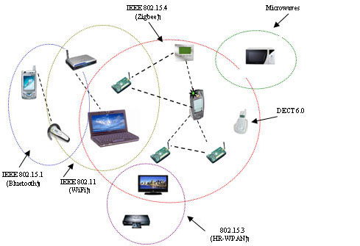
Sharing a common radio frequency
Communication interference is commonplace:
Interference avoidance as a basic form of inter-network cooperation

Slide 6
A preliminary conclusion
Static grouping of mobile devices is complex, inefficient and might lead to a waste of resources
Network solutions that dynamically support at run-time cooperation between devices from different types of networks are becoming a necessity.

Slide 7
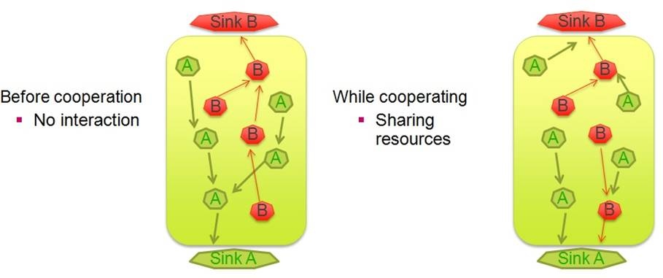
Networks cooperating

Slide 8
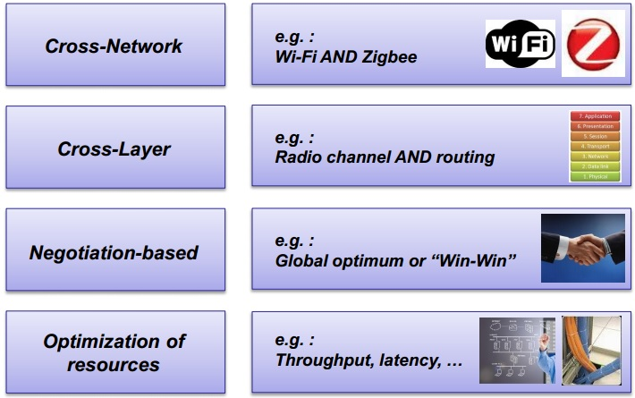
Incentive driven networking
A cross-layer, cross-network negotiation methodology for optimizing network resources

Slide 9
Incentive driven networking
Incentive describes a high-level network behavior or a reason for cooperation:
Describe behavioral aspects of the network
Express the need for additional functionality
Give an indication of the expected performance network metric
Examples:
High throughput, high reliability, low delay (better QoS)
High network lifetime
High coverage
Low exposure
Public access

Slide 10
Network services
Whereas incentives indicate network goals, network services are means to realize these goals
Network services should be understood as optimization techniques that have influence over one or more incentives
Examples:
packet aggregation and sharing, MAC protocols, interference avoidance techniques …

Slide 11
Activating network services has (positive or negative) influence not only in a network where the service is activated.
By carefully choosing which service to activate, networks can improve not only their own, but the neighboring network’s performance as well.

Slide 12
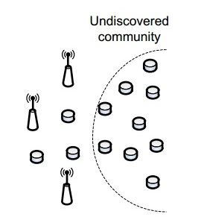
Incentive driven networking
Step 1:
Devices dynamically search for co-located devices with similar network preferences and hardware and/or software capabilities

Slide 13
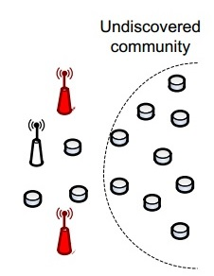
Incentive driven networking
Step 2:
If such devices are found, communities consisting of interconnected objects with similar network expectations are formed on an ad hoc basis

Slide 14
Incentive driven networking
Step 3:
Different communities will now able to cooperate with each other by activating and sharing (software or hardware) network resources.

Slide 15
The major issue
How to efficiently determine the optimal configuration parameters for all the participating networks, considering their high level goals and ensuring that the cooperation in mutually beneficial?

Slide 16
A self learning approach
There is a need for a reasoning entity that will initiate and control the cooperation process.
It will use certain performance metric to make an assessment of every relevant and utilized service combination, over an entire symbiotic network.
It must be able to automatically reconfigure all the participating networks, depending on a decision it makes.

Slide 17
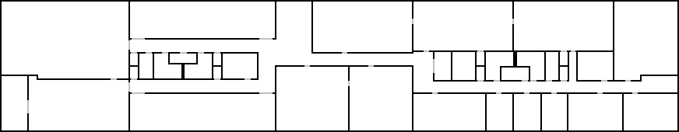
A self learning approach – use case
Final goal: three-tiered approach
Phase 1: Optimization of service settings (in-layer)
Phase 2: Selection of optimal service sets (cross-layer)
Phase 3: Cross-network negotiation (cross-network)
Also take into account the requirements of co-located networks
The goal:
Determine the best combinations of network services
B
A
B
A
B
B
A
B
A
B
A
A
A
B
A
Sink B
B
A
B
Sink A
A
Temperature sensor node (community A)
B
Intrusion detection sensor node (community B)

Slide 18
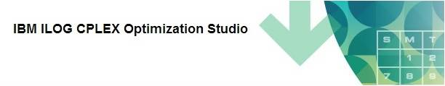
The initial approach
Linear programming (LP)
Negotiation entity (NE) collects network’s service profiles and “calculates” the optimal service set for every sub-net using an IBM’s linear programming engine

Slide 19
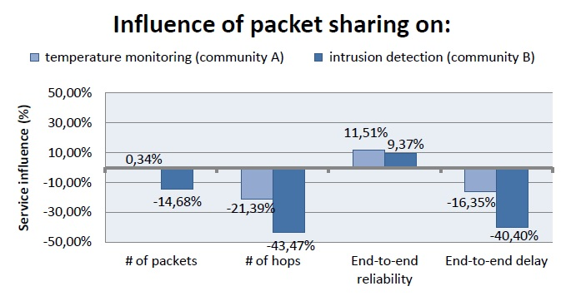
Disadvantages
Requires a priori knowledge - fixed benefits and costs for activating each service:
Eli de Poorter, Pieter Becue, Milos Rovcanin, ingrid Moerman, Piet Demeester, “A negotiation-based networking methodology to enable cooperation across heterogeneous co-located networks”

Slide 20
Disadvantages
Information about the service influences is extremely difficult to obtain:
Simulation
From a literature
Assumed …
Most of this data relates to static networking cases and change drastically when some of the network parameters change.
Conclusion:
ILP solver is a poor solution for dynamic environments

Slide 21
Possible alternatives
More adaptable to environments with fast changing parameters and much less demanding when it comes to a priory input information
Simulators
Mathematical modeling
Game theory
Machine – reinforcement learning

Slide 22
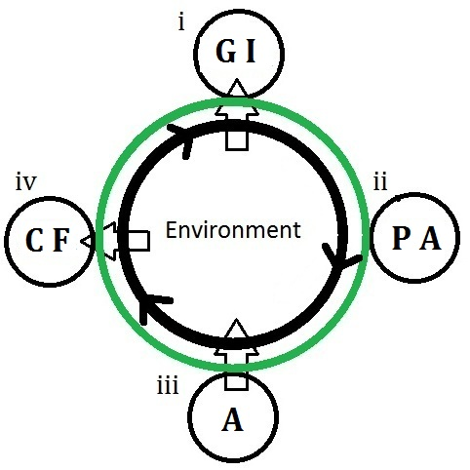
Cognition cycle
4-steps:
Gathering Information (GI)
Planning Actions (PA)
Act (A)
Collecting Feedback

Slide 23

Reinforcement learning
Modeled as a Markov decision process (MDP)
A decision maker goes through states: S = {S1, S2, … , S3}
Taking one of the available actions A = {a1, a2,… aN} at each step
The Bellman equation describes the learning process:
At each step, take the action that will maximize Q-value for the given state/action pair

Slide 24



Reinforcement learning
Bellman equation:
Immediate reward
expected future reward
state transition probability

Slide 25
The major issue
An MDP model differs from case to case. In most of them, it is not known a priory
A universal method for solving these kind of optimization problems has to be model-free

Slide 26

Least Squares Policy Iteration - LSPI
First Introduced in:
M. Lagoudakis and R. Parr. “Model-free least-squares policy iteration”. In Proc. of NIPS, 2001.
Instead of relying on a pre-learned MDP model, an agent collect process samples
One set can be used for different policies
Additional samples can be added, during the learning process, to an existing set

Slide 27


Least Squares Policy Iteration - LSPI
Approximates Q-function with its linear represent:
- basis functions represent a network’s feature (e.g., residual energy of s’, link quality between s and s’ etc.)
- a corresponding weight factor

Slide 28
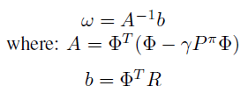
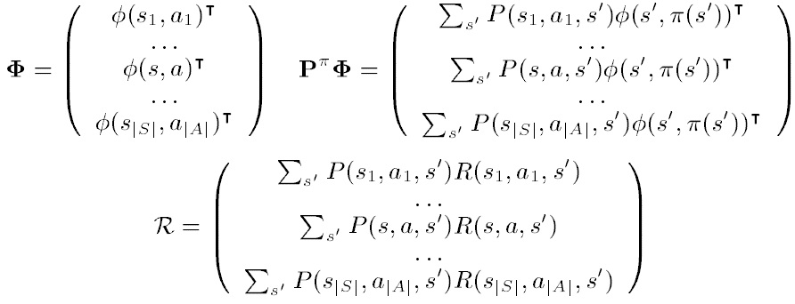
Least Squares Policy Iteration - LSPI
After combining the Bellman equation and it’s linear approximation:
And the corresponding matrices are given as:

Slide 29
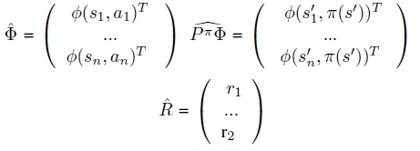

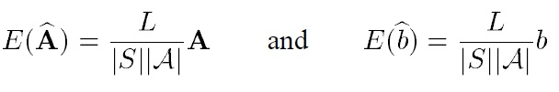
Least Squares Policy Iteration - LSPI
Approximated values for matrices:
- In fact represents a probability P((s’,a’) | (s,a))
To improve consistency between the approximated and the actual values:

Slide 30
Least Squares Policy Iteration - LSPI
LSPI - strong points:
It converges faster than all other known algorithms, since the samples are used more efficiently.
It does not require fine tuning of the initial parameters such as learning rate
LSPI learns the weights of the linear functions and updates Q-values based on the most updated information regarding the features, while in other approaches agents make decisions directly based on Q-values, which may be outdated, depending on the network dynamics.
The same set of samples is used to evaluate different policies

Slide 31
Implementation
Milos Rovcanin, Eli De Poorter, Ingrid Moerman, Piet Demeester, “A reinforcement learning based solution for cognitive network cooperation between co-located, heterogeneous wireless sensor networks”, AD HOC Networks, 17: 98-113 (2014)
Sub-net A: temperature monitoring sensor nodes
Incentives: high network lifetime
Available services: packet sharing, aggregation
Sub-net B: temperature sensor nodes
Incentives: low delay, high network lifetime
Available services: packet sharing, aggregation
B
A
B
A
B
B
A
B
A
B
A
B
A
A
A
Sink B
B
A
B
Sink A
A
Temperature sensor node (community A)
B
Intrusion detection sensor node (community B)

Slide 32
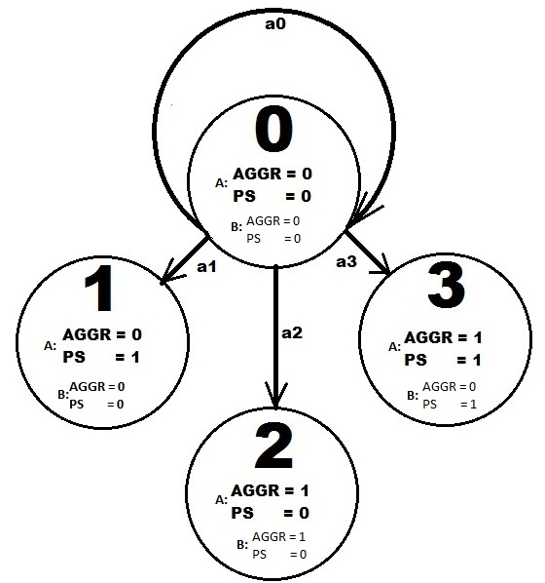
Implementation
A service combination represent a state
S = {s0,s1,s2,s3}
Activating or deactivating a service
is considered to be an action
A = {a1,a2,a3,a4}
Reuse of the existing data (CPLEX ILP Solver)
- reduced set of states and constrained actions

Slide 33
Implementation
Two phase process:
Exploration phase – Exhaustive search through the state problem space, investigating every service combination
Exploitation phase – use “Epsilon greedy” algorithm to enforce optimal decisions, while staying versatile to adapt to possible network condition changes

Slide 34
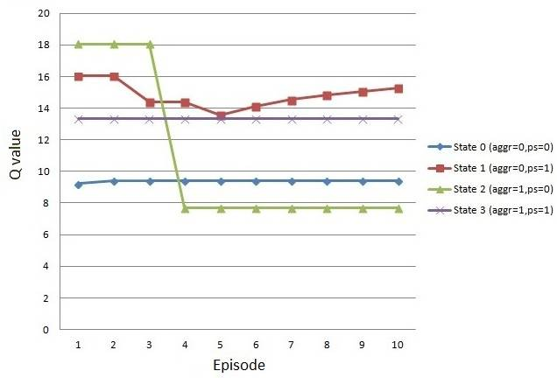
Implementation
Exploration phase:
Collect the information about
every state/action pair, using the
memoryless property of the MDP
Use a pseudo random walk to
collect samples
Once it is done, calculate the
initial set of weights and Q values

Slide 35
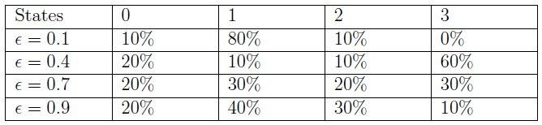
Implementation
Exploitation phase:
Percentage of the number of episodes that system have spent in each state during a particular experimental run. Each run is characterized by a different value of the “epsilon” factor = (0.9, 0.7, 0.4, 0.1).

Slide 36
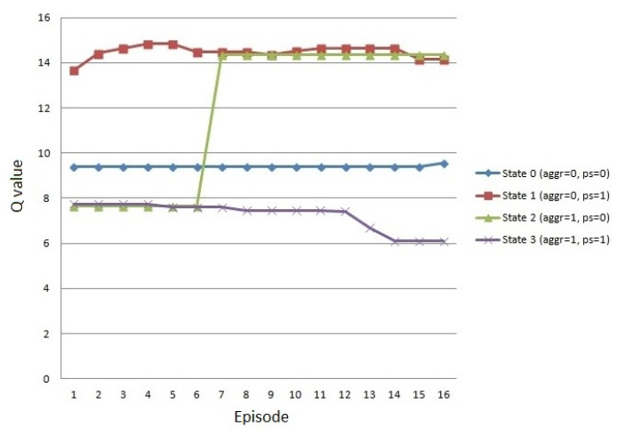
Implementation
The “worst case” scenario:
The optimal and the worst performing service combinations switch performances (not highly probable – for a demonstration purpose only)

Slide 37
Open issues
To find an optimal value for the “epsilon” factor:
forcing the optimal service combination vs. versatility to condition changes
Scalability of the algorithm:
emphasize on an exploration phase
Stopping rules

Slide 38
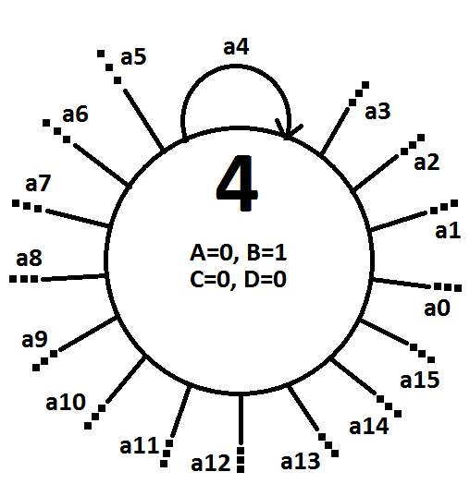
Implementation – a more complex use case
16 experimental service combinations (e.g A, CD, ABD …)
Pre-estimated influences for each combination
16 actions available at every state
One basis function per incentive – Phi1, Phi2 (e.g. end-to-end delay, average number of re-transmissions)

Slide 39
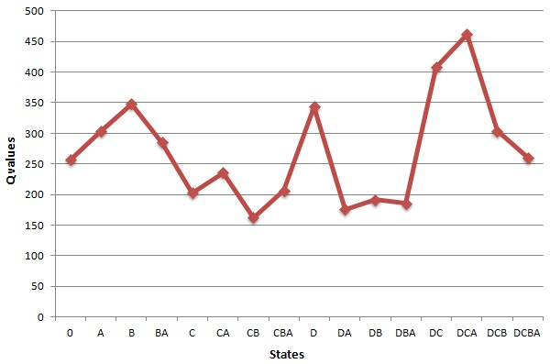
Implementation – a more complex use case
Exploration phase:
Calculate the initial set of weights (ω1, w2)
Calculate the initial set of Q values for every state/action pair

Slide 40
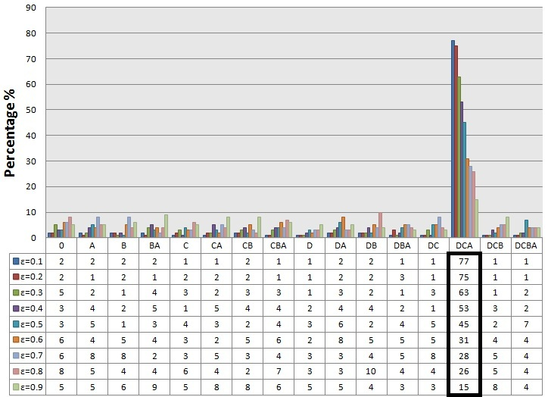
Implementation – a more complex use case
Exploitation phase (epsilon greedy)
Results after 100 learning episodes, no disturbances present:

Slide 41
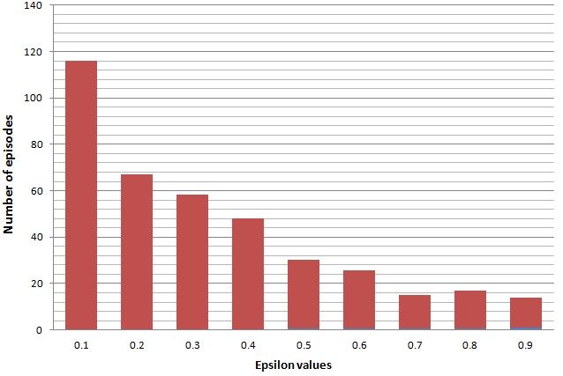
Implementation – a more complex use case
Exploitation phase:
Reaction to a network condition disturbance (worst case scenario)

Slide 42
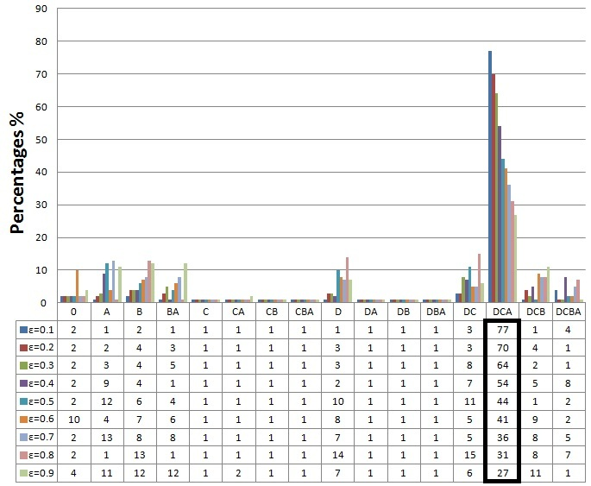
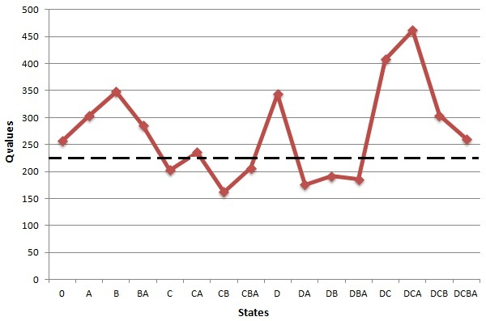
Implementation - a more complex use case
Exploitation phase:
Introducing a simple efficiency-improving procedure
Q value threshold:
Effects:
No significant difference in the number of episodes spent in the optimal state
Significant reduction in the number of episodes spent in the worst performing states

Slide 43
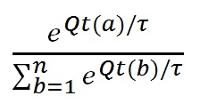
Implementation – introducing SOFTMAX
SOFTMAX exploiting strategy:
Probability of choosing a service combination depends on it’s Q value.
τ is a positive parameter called the temperature. Low temperatures cause a greater difference in selection probability for actions that differ in their value estimates.

Slide 44
Implementation – an even more complex use case
Exploring 32 different states
Real life measurements
Sub-net A: temperature monitoring sensor nodes
Incentives: high network lifetime
Available services: packet sharing, aggregation
Sub-net B: temperature sensor nodes
Incentives: low delay, high network lifetime
Available services: packet sharing, aggregation
B
A
B
A
B
B
A
B
A
B
A
B
A
A
A
Sink B
B
A
B
Sink A
A
Temperature sensor node (community A)
B
Intrusion detection sensor node (community B)

Slide 45
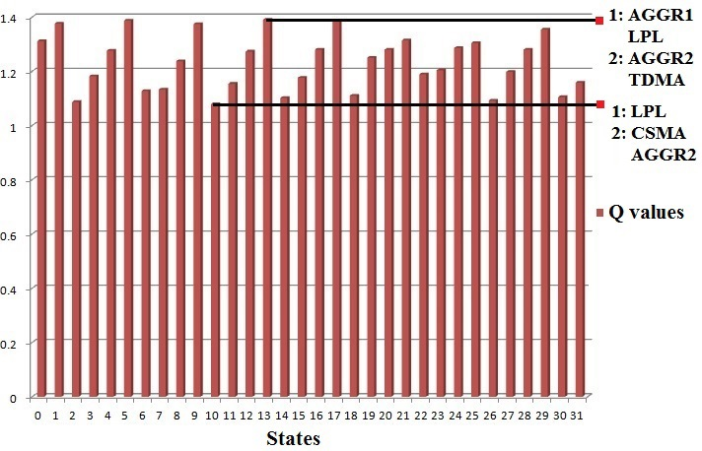
Implementation – an even more complex use case
Exploration phase results:

Slide 46
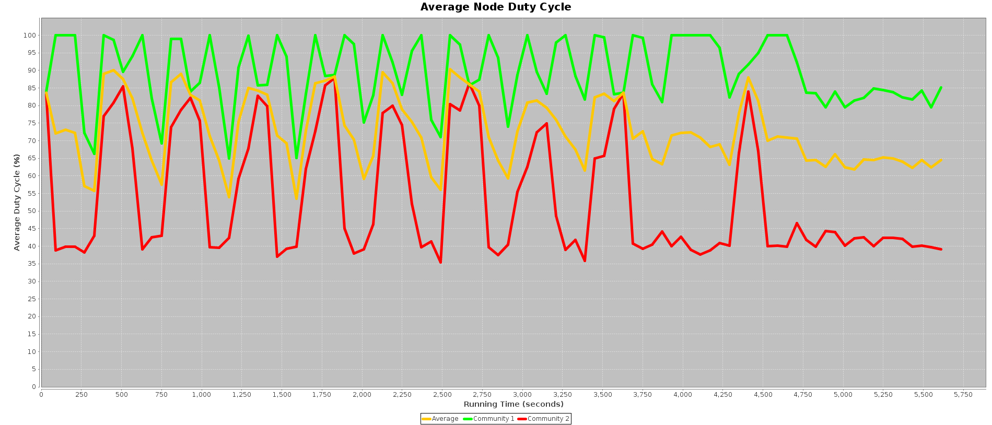
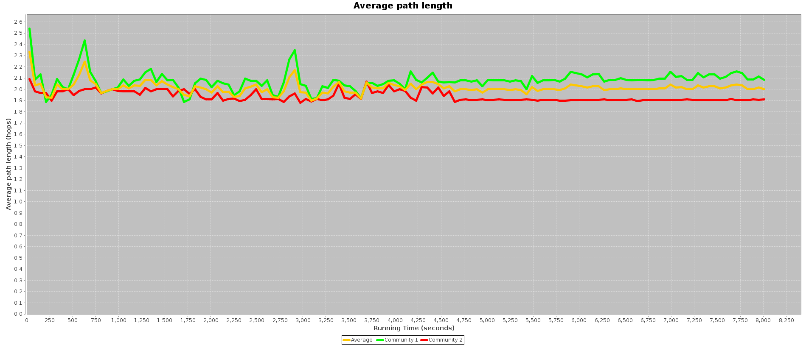
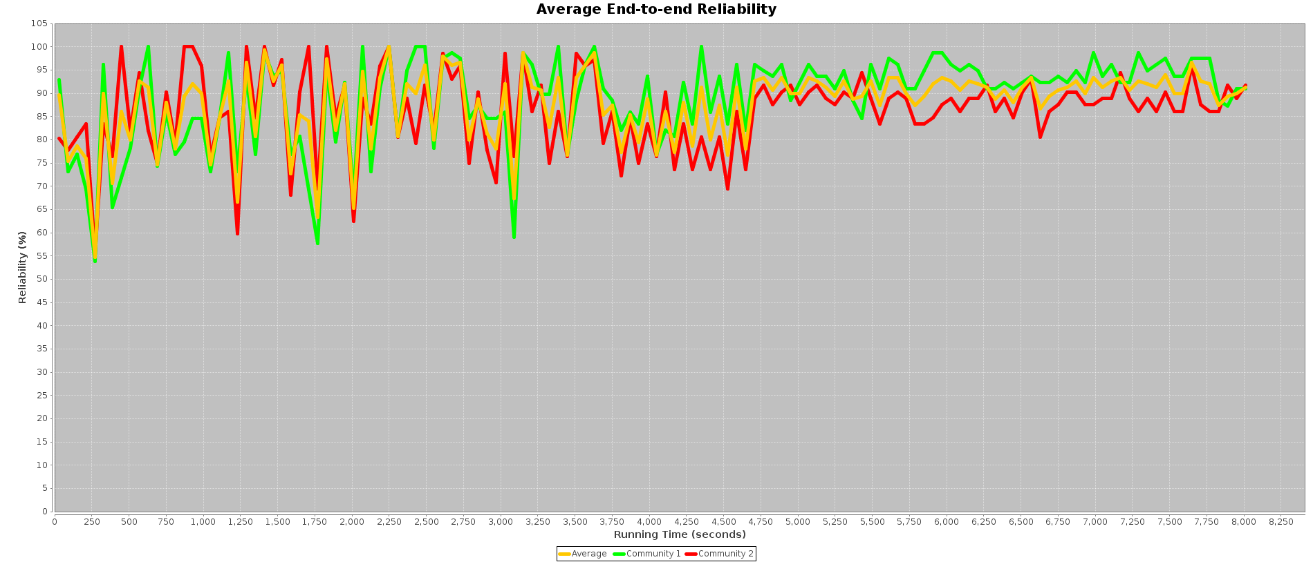
Implementation – an even more complex use case
Exploration phase results - steady network conditions:

Slide 47
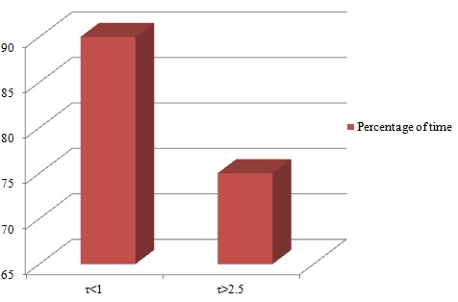
Implementation – an even more complex use case
Steady network conditions:
For the temperature factor values < 1, SOFTMAX enforces the optimal service combination for over than 90% of time
For comparison, for values higher than 2.5, the percentage drops below 75%

Slide 48
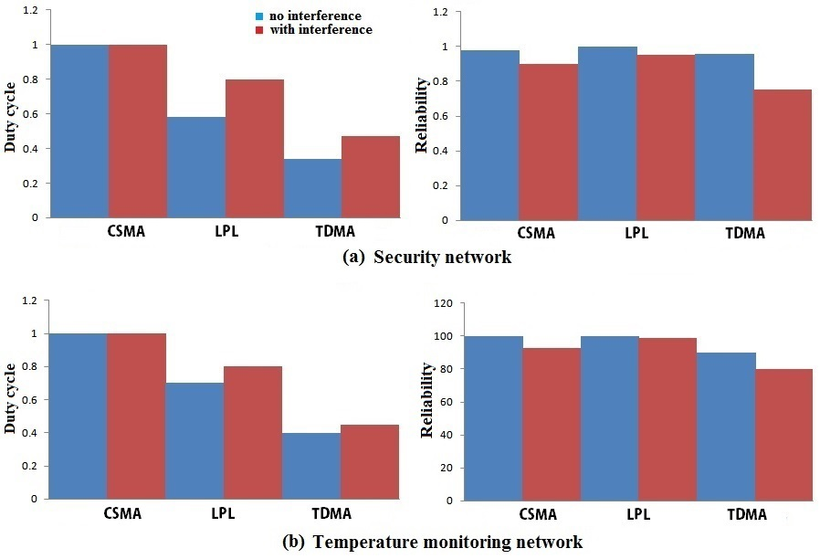
Implementation – an even more complex use case
Performances of the (a) Security network and (b) temperature monitoring network,
in terms of a duty cycle and reliability metrics, in situations with and without
influences of co-located devices.

